Slide 1
DS 5100 Project:
Food Deserts
Max Jones, Kaia Lindberg, Grace Lyons, Mani Shanmugavel
December 2021

Slide 2
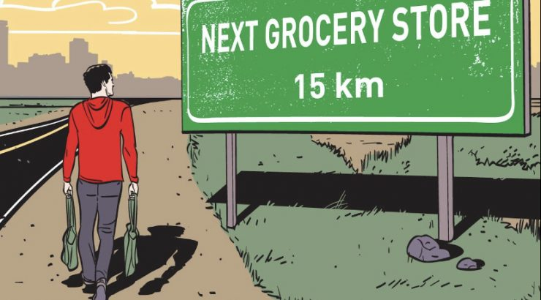
Food Deserts
In this project, we wished to examine the relationships of food deserts across the US
Food deserts: geographic areas where residents have few to no convenient options for securing affordable and healthy foods — especially fresh fruits and vegetables

Slide 3
Research Question 1
Where do food deserts occur?
To answer, we wished to compare the occurrence of food deserts to the following:
Population
Metro Status (city vs non-city)
Region (Northeast, Midwest, West, South)
Ethnicity
Adds research question about new york or state level analysis in general
Notes:
In particular, we aimed to identify areas that might contain food deserts so that help could be administered appropriately. To identify these areas, we planned to analyze food deserts with the following to examine exactly where food deserts may occur:

Slide 4
Research Question 2
How could our project be used to analyze specific areas?
To answer, we will demonstrate our project with an analysis into a single state.
Adds research question about new york or state level analysis in general
Notes:
Additionally, we wished to demonstrate how our project might be used in specific areas by examining food deserts in the context of a single state, where we could gain clearer insight (less noise from country-wide data).
Residents who have lower levels of education, lower incomes, and higher rates of unemployment

Slide 5
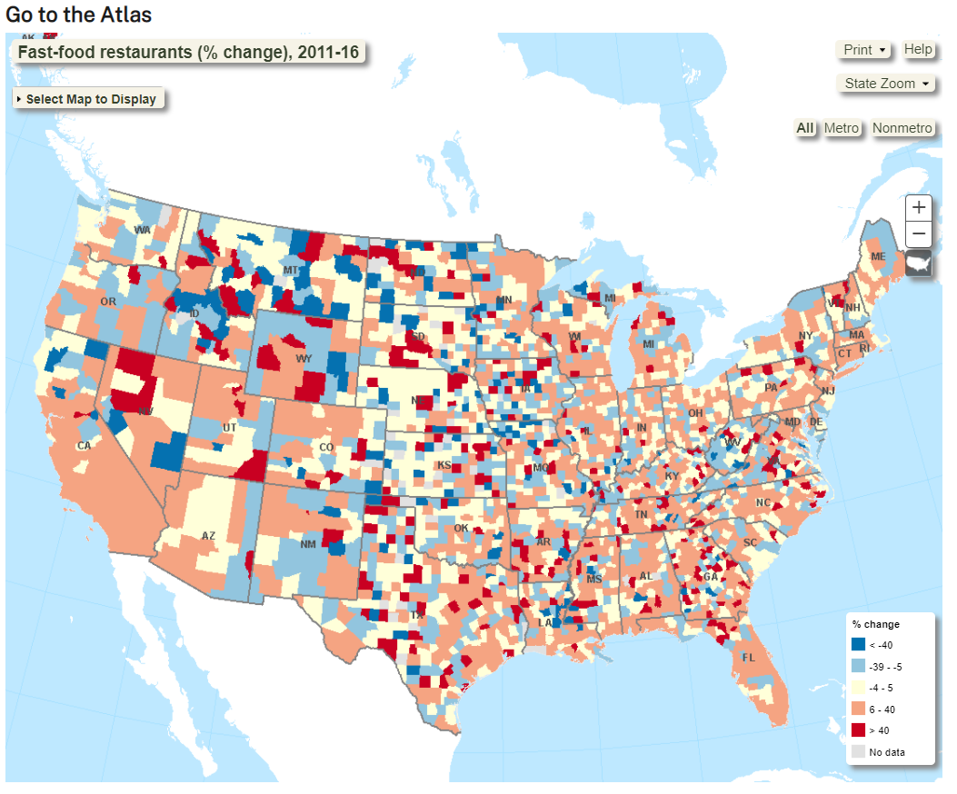
Project Scenario
--Data set source: USDA Food Environment Atlas
--Contains various statistics for each county in the US
--Over 250 variables, including:
Food Choices
Food store accessibility (access/proximity)
Type of stores
Availability of fresh and local foods
Health and Wellbeing
Obesity and diabetes rates
Recreation and physical activity levels
Community characteristics
Metro/non-metro
Ethnicity percentages
Income and poverty

Slide 6
Variables of Interest
2015 Census Population
Metro Status
Region
Ethnicity Percentages
Percentage of low income, low access to food
--Variable that measures what percent of the population is classified as having a low income and low access to food
--Used this to measure food deserts

Slide 7
Project Pipeline
Source data from USDA, load into Python, preliminary analysis, evaluate quality
Perform data analysis to process the data and identify variables of interest
Acquisition
Analysis
Future Work...
Cleaning
Results
Transform data, clean columns, and address inconsistencies in the data
Create visualizations to make meaning of and communicate results

Slide 8
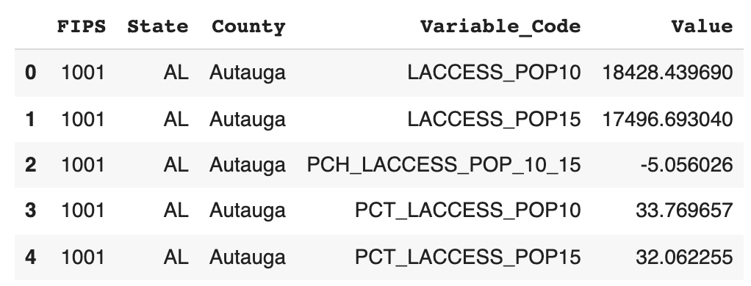
Data Cleaning
Wrote a class with methods for each data cleaning step to improve readability and facilitate testing
1
Clean state column to handle extra spaces
“VA” versus “ VA”
2
“Raleigh” versus “Raleigh County”
Webscrape FIPS lookup table to resolve inconsistencies in county names
3
Reformat data so 1 row for each FIPS code and each variable is a column
4
Split county and state level data into two separate dataframes
Notes:
Before we could begin our analysis, we had to clean the data.
We wrote a class to perform our data cleaning to improve readability, facilitate testing, and allow for more repeatable analysis in the future
Cleaning data in State column
White space in state names (“VA” versus “ VA” versus “VA “)
Cleaning county coulmn
The county names were very messy (different spellings and naming conventions like “Norfolk” vs “Norfolk County”) so we opted to web scrape and then use a lookup table based on the unique FIPS codes for each county
Had to fill in a few missing FIPS codes with the state and county names from our dataset
Re-formatting
Original data format had each variable as a row so we re-formatted it to have the variables across the columns
State vs county level variables
Some variables were at a state level and thus were missing for all county level FIPS codes and vice versa for county level variables
We opted to split the data into two dataframes
(NEXT SLIDE) Our resulting data frames were much cleaner and ready for us to analyze.

Slide 9
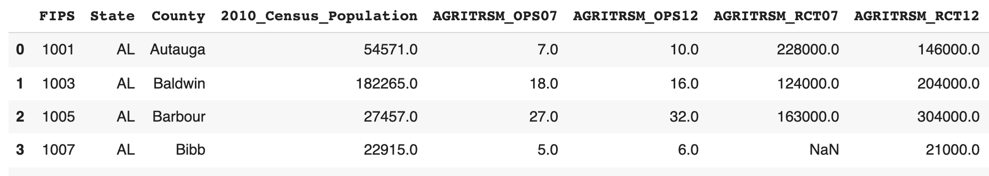
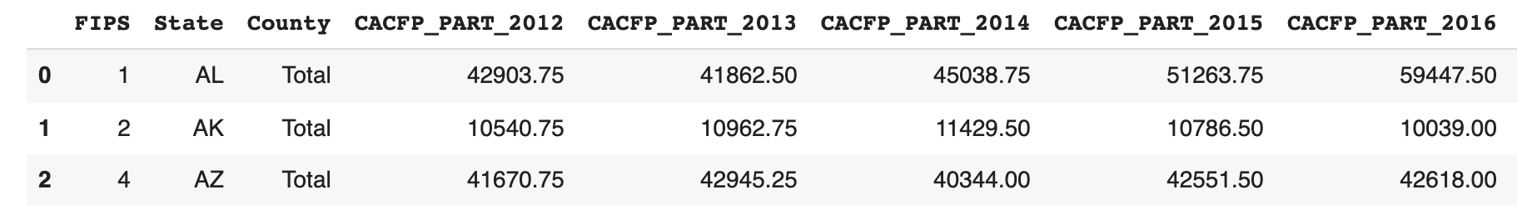
Data Cleaning
Wrote a class with methods for each data cleaning step to improve readability and facilitate testing
1
Clean state column to handle extra spaces
“VA” versus “ VA”
2
“Raleigh” versus “Raleigh County”
Webscrape FIPS lookup column to resolve inconsistencies in county names
3
Reformat data so 1 row for each FIPS code and each variable is a column
4
Split county and state level data into two separate dataframes

Slide 10
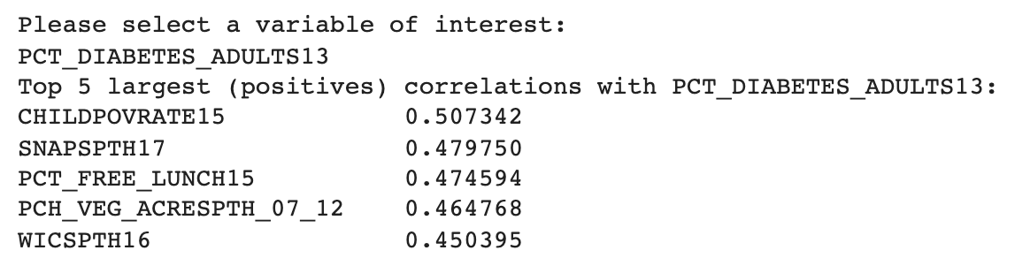
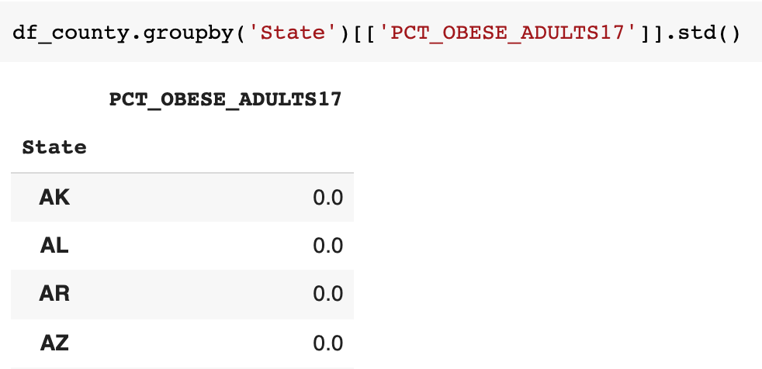
Data Analysis
Filtering down to a single state
Remove missing values based on threshold
User interaction to make selections for analysis
Calculate correlations between variables of interest
Keep only the most recent column
Remove “hidden” state level variables
Examples
Variable_Name | Variable_Code
Population, low access to store, 2010 | LACCESS_POP10
Population, low access to store, 2015 | LACCESS_POP15
Notes:
As we were analyzing the data we found that we were often repeating similar analysis so we wrote these processes as methods in a class so that we could test, share, and re-use these functions to complete our analysis more easily and efficiently.
For example, we’ve built in functionality to allow users to select a state, calculate correlations between variables of interest, remove missing values, remove certain variables (i.e. older data, zero variance columns), and more. We didn’t want to include all of these in the initial data cleaning process because some of these decisions may differ depending on the analysis (e.g. whether you want to keep variables with zero variance within a state, whether you want to compare across years versus just keeping the most recent year).

Slide 11
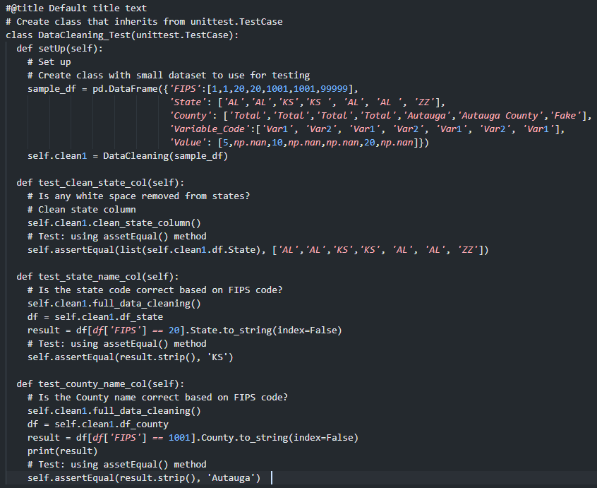
Testing
Developed Classes to clean and analyze data
Thorough unit testing of cleaning and analysis class using assertEqual()
Used test fixtures like setup() to set up the test cases
Data gathered for State and County FIPS codes through Web scraping was also tested

Slide 12
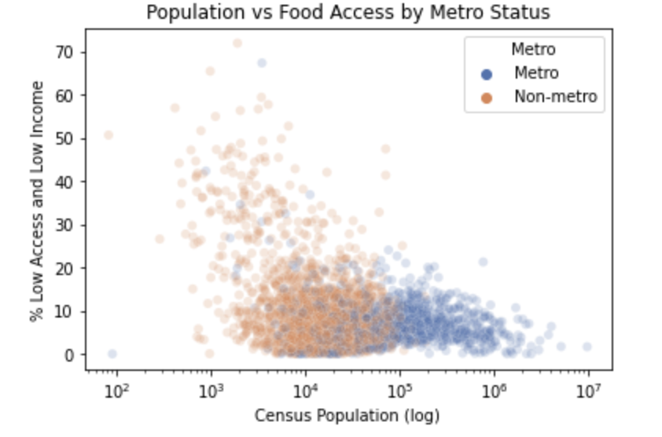
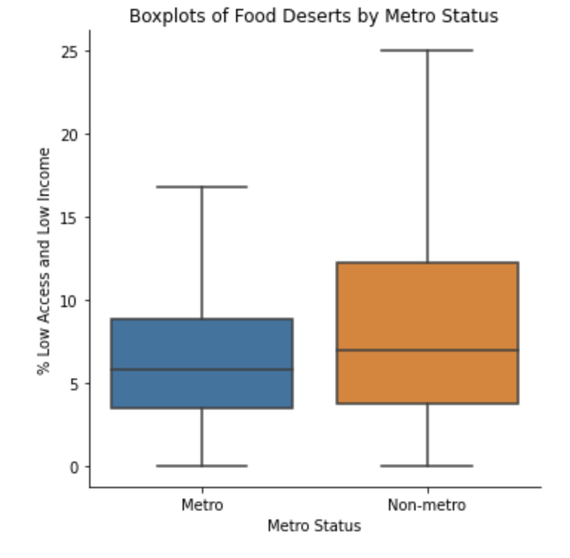
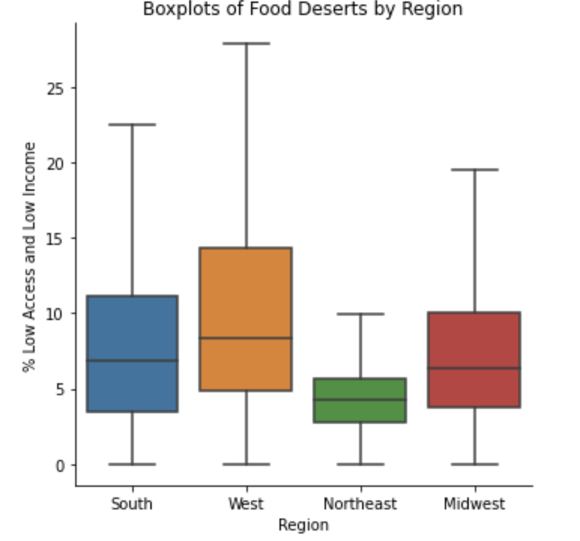
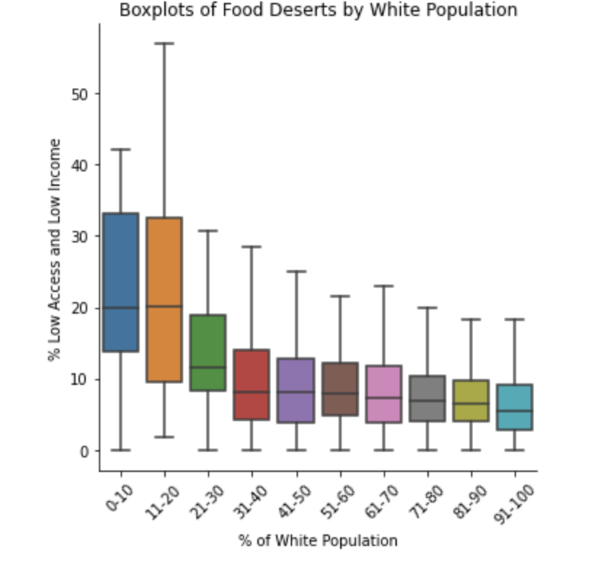
Food Deserts are more common in...
Low Population
Non-metro Areas
West Region
Areas with Lower White Population
Notes:
We looked at a variable that measured % low access and low income as food desert
Low population:
Majority of counties average around 10% low income, low access
As expected, almost all of the food desert areas occur in non-metro areas
Non-metro areas:
Non-metro areas have higher range and average than metro areas
Non-metro higher risk for food desert
West Region:
Highest range and average occur in the West
Lowest range and average in the Northeast
Outside northeast higher risk for food deserts
Areas with lower white population:
For high levels of White population, low access levels seem relatively steady at around 10%
For low levels of White population, low access levels rise up to an average of 20% with a range of over 50% in lower levels.
Areas of low white population seem to be at the most risk of containing food deserts.

Slide 13
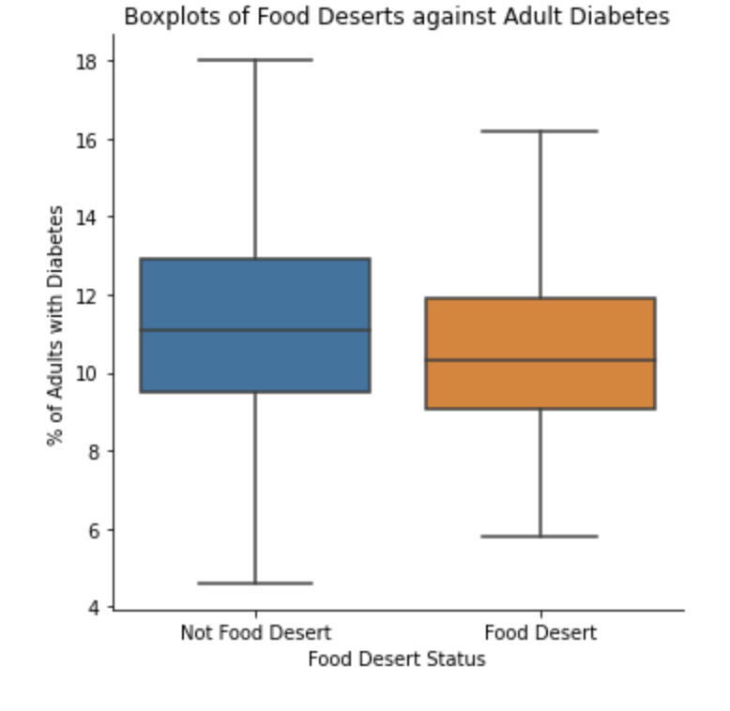
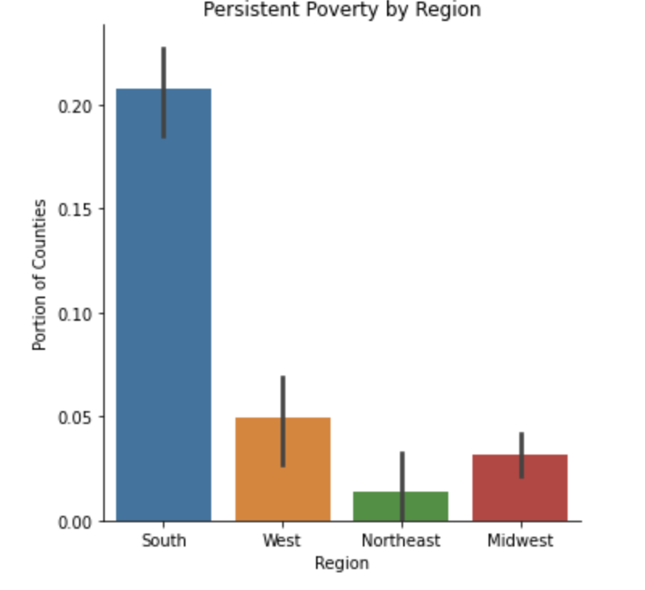
Food Deserts and other Variables
Diabetes Rate
Poverty Persistence Rate
Notes:
Diabetes Rate:
To further illustrate the impact of food deserts, we were curious to see if there was any relationship between food deserts and diabetes rates.
We said that counties with greater than 33% low acces and low income were food deserts
We can see that diabetes rates is about the same between food deserts and non food desert counties
Poverty Persistence Rate:
a persistent poverty county as one in which "20 percent or more of its population [has lived] in poverty over the past 30 years"
From the previous slide, we know that the northeast has the lowest rate of low acces and low income and from here we see it also has the lowest rate of poverty persistence
While west had the highest rate of low access to food and low income, from the previous slide, we see that the south has the highest rate of poverty presistence

Slide 14
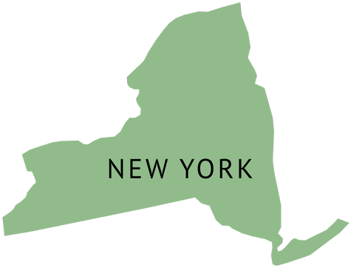
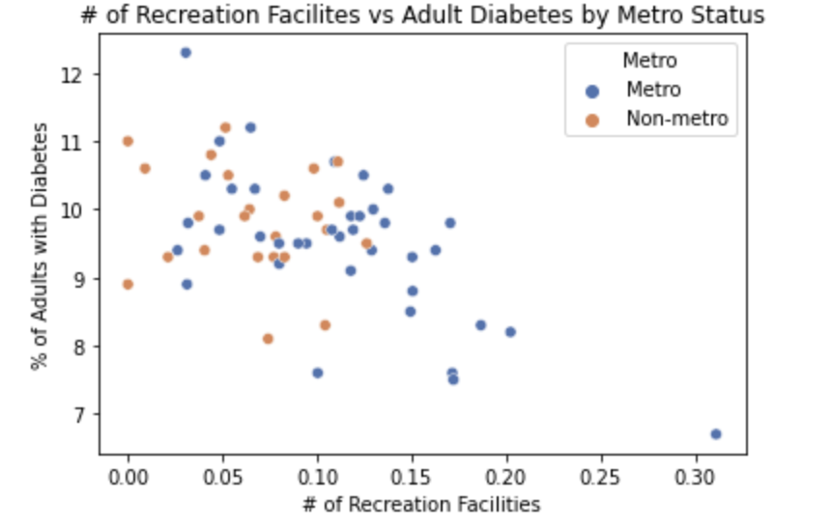
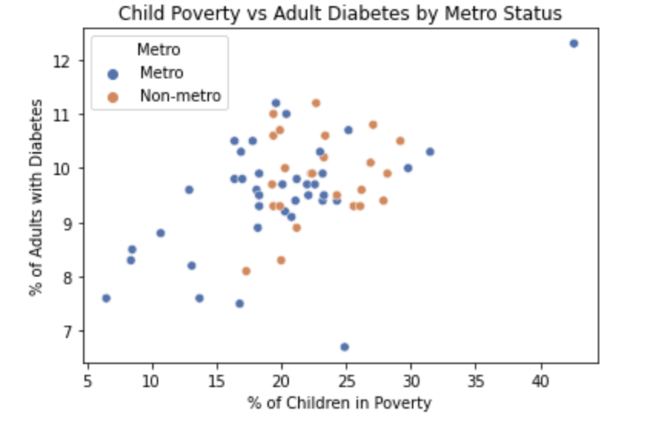
We’ve also analyzed relationships between variables within a single state
# of Recreation Facilities vs Adult Diabetes
Child Poverty vs Adult Diabetes
Notes:
Motivation: For many of the variables there was so much variability and noise in the data that it was difficult to visualize relationships between variables of interest. In addition, we thought it would be useful for certain types of analysis to be able to dig deeper into the counties in a single state.
For the purpose of this example, we’ve chosen New York, but we’ve built in the functionality to make this process repeatable for the analysis of any state. We’ve chosen New York for this example because it is a pretty large state and also had the largest value for food insecurity in this dataset.
Using the correlations with diabetes as a guide, we’ve visualized the relationship between different variables and diabetes in New York, in this case child poverty rate and number of recreation facilities
Counties with higher child poverty rates also tend to have higher adult diabetes rates

Slide 15
Conclusions--Question 1
Where do food deserts occur?
Small population
Non-metro
West, Midwest, and South regions
Low White population
Notes:
From this project, we were able to examine the relationships between food deserts and various factors to determine that food deserts are likely to occur in areas with the following characteristics:

Slide 16
Conclusions--Question 2
How could our project be used to analyze specific areas?
For New York:
Negative correlation between adult diabetes rate and number of recreational facilities
Positive correlation between child poverty rate and adult diabetes rate

Slide 17
Significance of Results
In areas we determined to be food deserts, one could:
Incentivize grocery stores and supermarkets
Fund city-wide programs to encourage healthier eating
Extend support for small, corner-type stores and neighborhood-based farmers markets
Notes:
For future use, our results can be used by others in that they can help spread awareness of food deserts in areas where help is needed. For example, i

Slide 18
For Further Investigation
Additional research into all 250 variables
Machine learning model to more accurately predict food desert locations
Perhaps obtain more accurate food desert variable that emphasized healthy food over all food

Slide 19
Works Cited
www.aecf.org/blog/exploring-americas-food-deserts
www.ers.usda.gov/data-products/food-environment-atlas/
https://www.ers.usda.gov/webdocs/publications/45014/30940_err140.pdf

